Slide 1
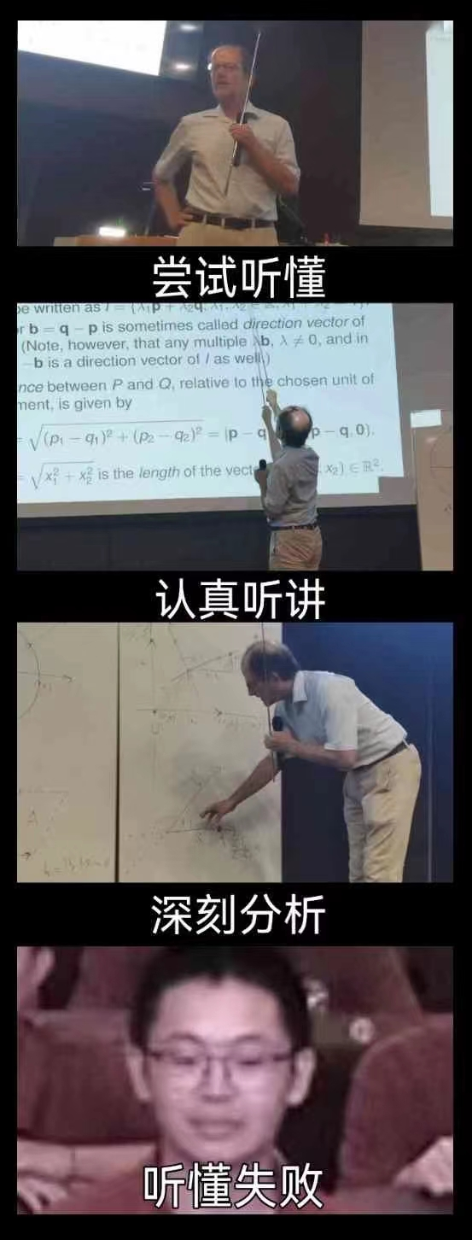
MATH 285 Week 3 DI 2

Slide 2


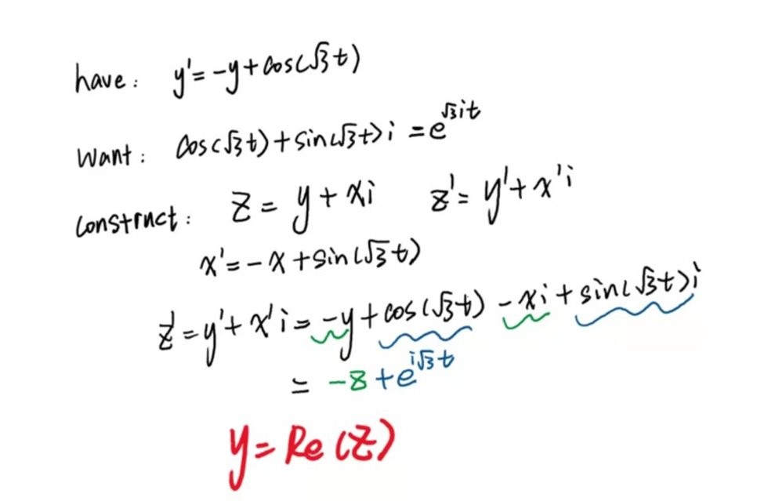
Recap

Slide 3
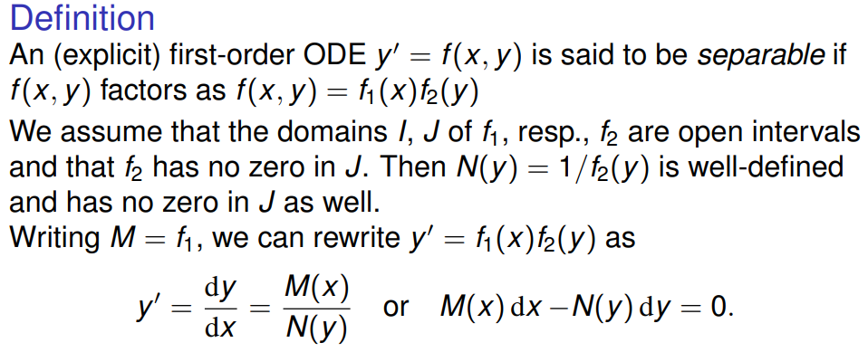
Separable Equations

Slide 4


Slide 5
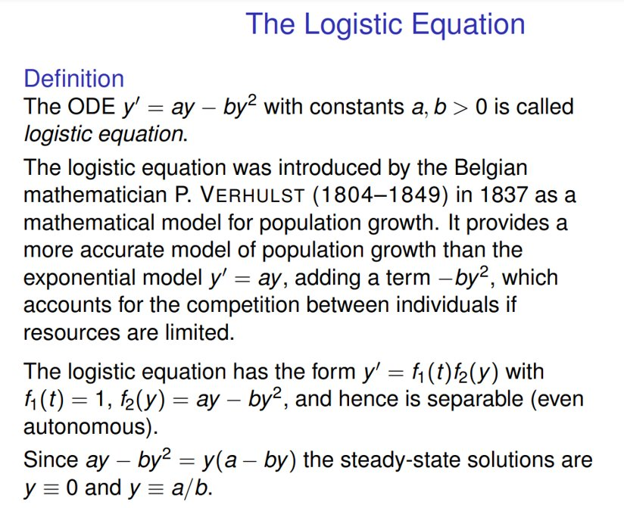

Slide 6



Slide 7
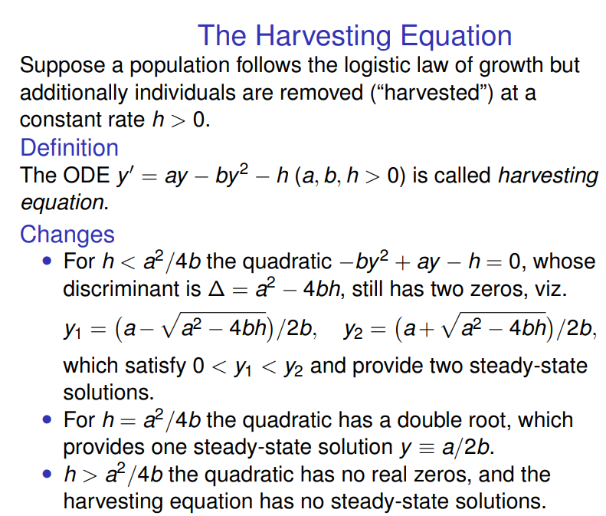

Slide 8


Slide 9
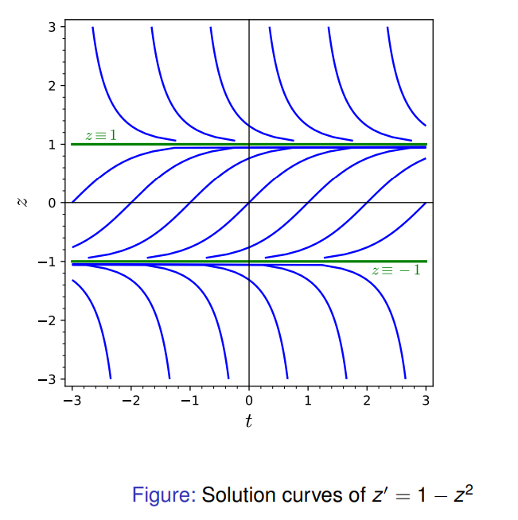

Slide 10
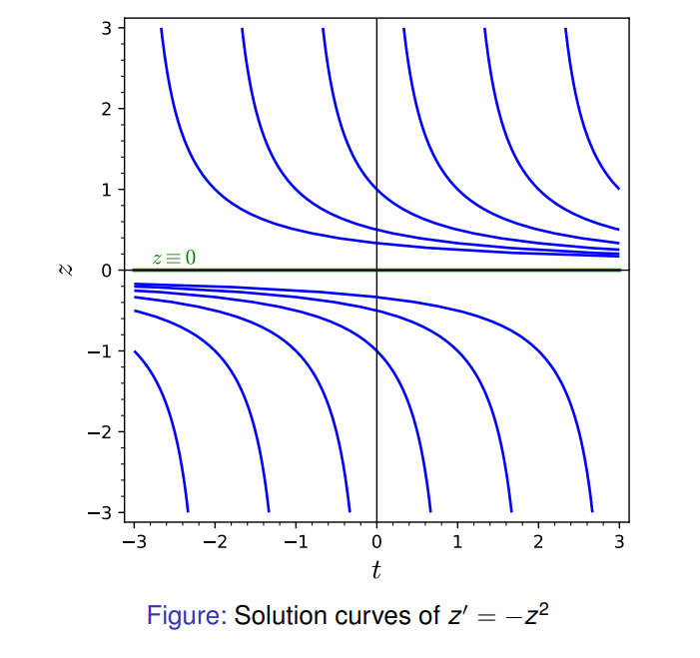

Slide 11
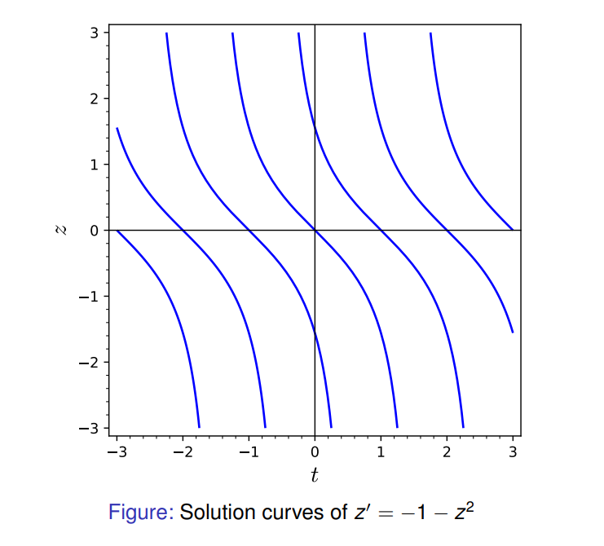

Slide 12
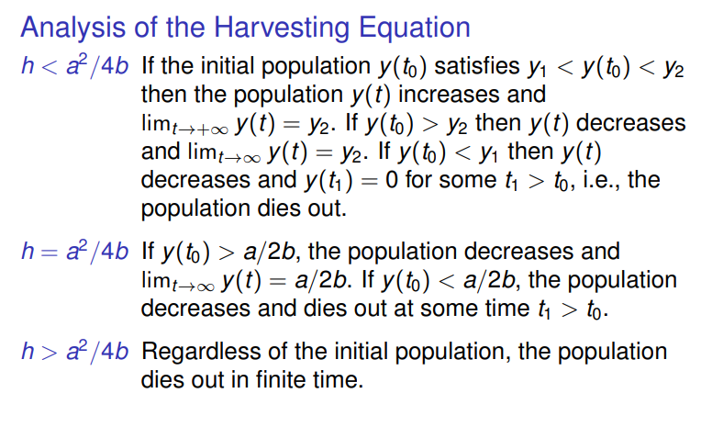

Slide 13



Exact First-Order Equations

Slide 14



Slide 15

Integrating Factor

Slide 16
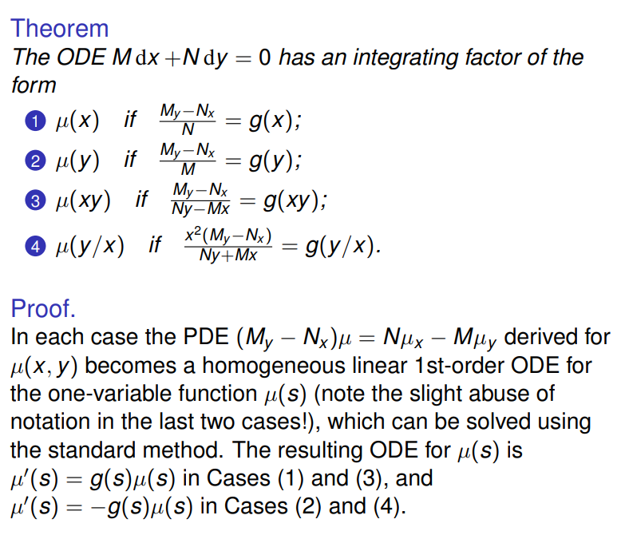


Slide 17


Slide 18


Slide 19


